Slide 1



Analysis of DonorsChoose.org Applications
MGMT 58600 Group Project
Team 6
Class 2
Professor - Dr. Yang Wang
TA - Ayush Maheshwari

Slide 2
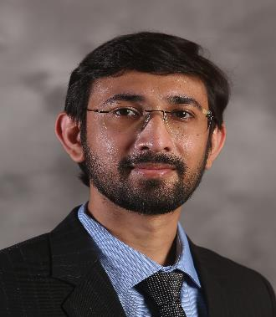
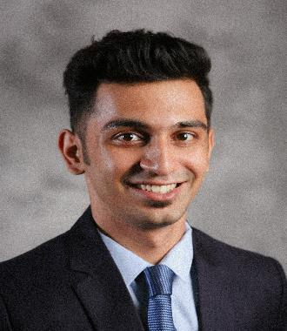
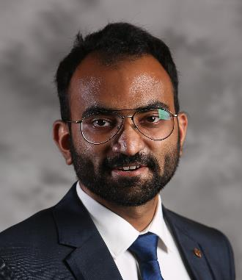
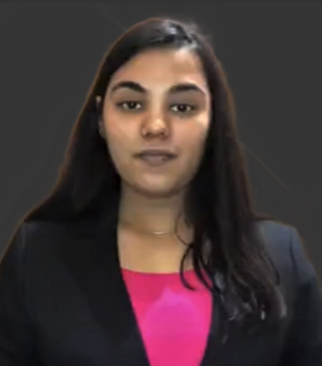

Meet the Team
Kshitij Virdi
Adithya Kothari
Sagar Baronia
Puja Gupta
Gagan Pahuja

Slide 3

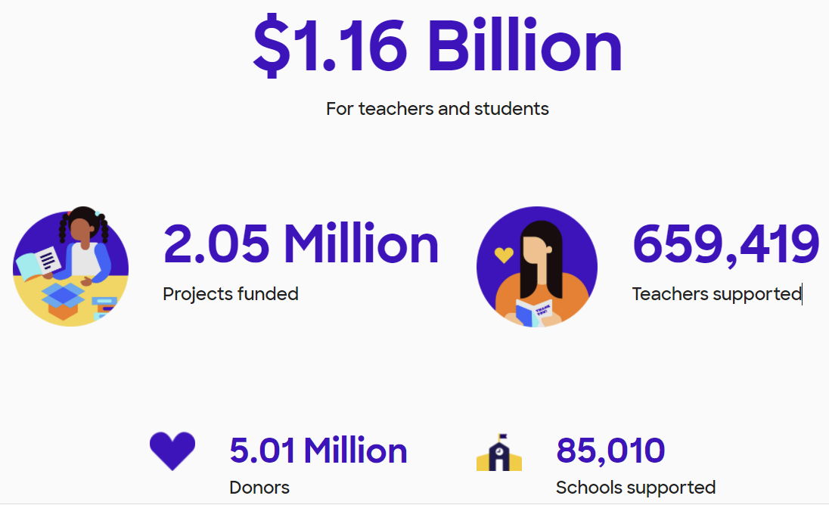

Slide 4

Application Process
Donors
Volunteers
Help in Application process
$ Project- 3
$ Project- 1
Approved
Approved
Application
Rejected
Application
Application
Project 1
Project 2
Project 3

Slide 5


Problem Statement
Volunteers
Applicants
The selection of applications is a long and tedious process involving hundreds of volunteers. Significant effort and time is involved in this process.
There is a need to standardize and simplify this process to ensure quick and consistent approval/rejection decisions.
A solution to this would be to build a model that can classify the application based on several parameters.
New applicants are not fully aware of what a good application looks like. This results in good projects being rejected.
A solution to this would be to understand the historically successful applications and build recommendations that future applicants can adhere to.

Slide 6
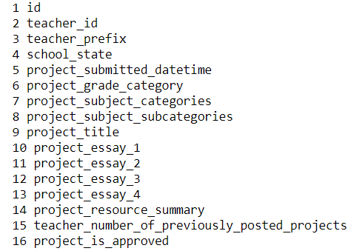

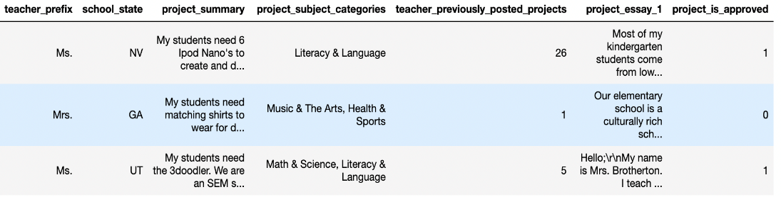
Understanding the Data
Summary
Teacher History
Essays
States
Subjects
Approval
Resources Dataset
Interesting Attributes
Application Dataset

Slide 7



Challenges with Data
Large Dataset
Two tables with 180k+ and 150k+ records
Multiple columns with textual data ranging between 10 to 1000 words
Large computing power required
Text Data
Removing the redundant filler words and punctuations from the essays/summaries
Ambiguity in understanding context and spread of sentiment

Slide 8

Data Cleaning and Pre-processing (1) :
Quantifying data from textual columns such as Project Summary
teacher_prefix | school_state | project_submitted_ datetime | project_grade_ category | project_subject_ categories | project_subject_ subcategories | project_title | project_essay_1 | project_resource_ summary | teacher_number_of_previously_posted_ projects | project_is_ approved
Ms. | NV | 2016-11-18 14:45:59 | Grades PreK-2 | Literacy & Language | Literacy | Super Sight Word Centers | Most of my kindergarten students come from low... | My students need 6 Ipod Nano's to create and d... | 26 | 1
teacher_prefix | school_state | project_grade_ category | project_subject_ categories | project_subject_ subcategories | teacher_prev_ posts | cleaned_project_ title | cleaned_ essay | cleaned_resource_ summary | digit_in_ summary
ms | nv | grades_prek_2 | literacy_language | literacy | 26 | super sight word centers | kindergarten students come low income househol... | students need 6 ipod nano create differentiate... | 1
Show Code |

Slide 9

Data Cleaning and Pre-processing (2):
Extracting Stop words & Punctuations
Before:
After:
Show Code |

Slide 10
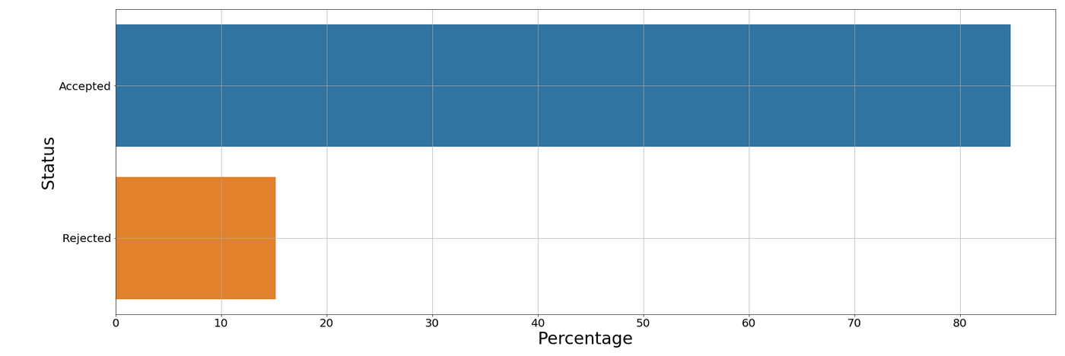
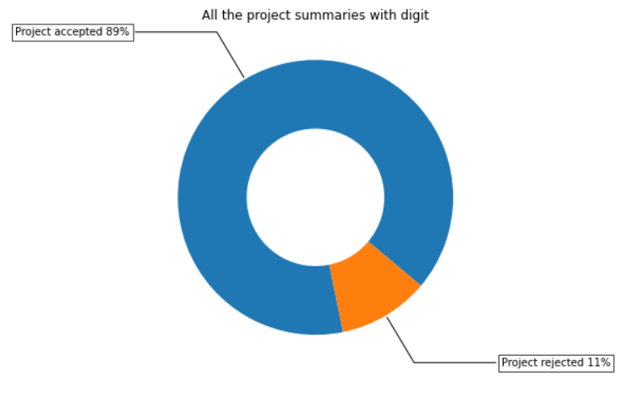
Current Approval Rate
The approval rate for the applications currently stands at 85% whereas the rejection rate of all the past applications stands at 15%.
The approval rate for the applications containing digits in their summaries is 89% as opposed to 11% in the case of applications containing no digits.
Show Code |

Slide 11
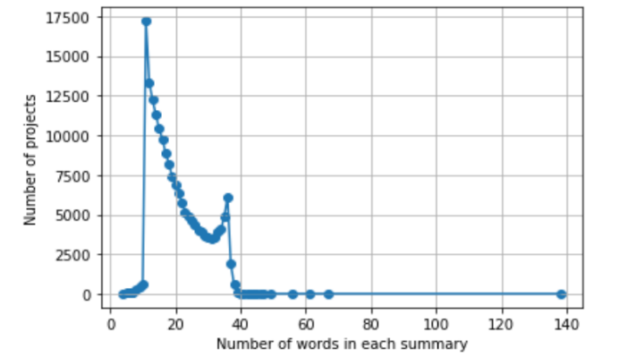
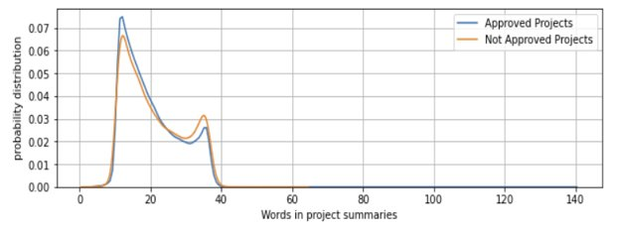
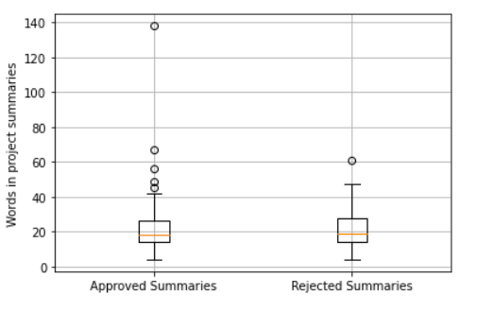
How important is the summary?
Attributes | Minimum | Maximum | Average
Length of summary | 25 | 902 | 122.3
# words in summary | 4 | 138 | 20.3
Show Code |

Slide 12
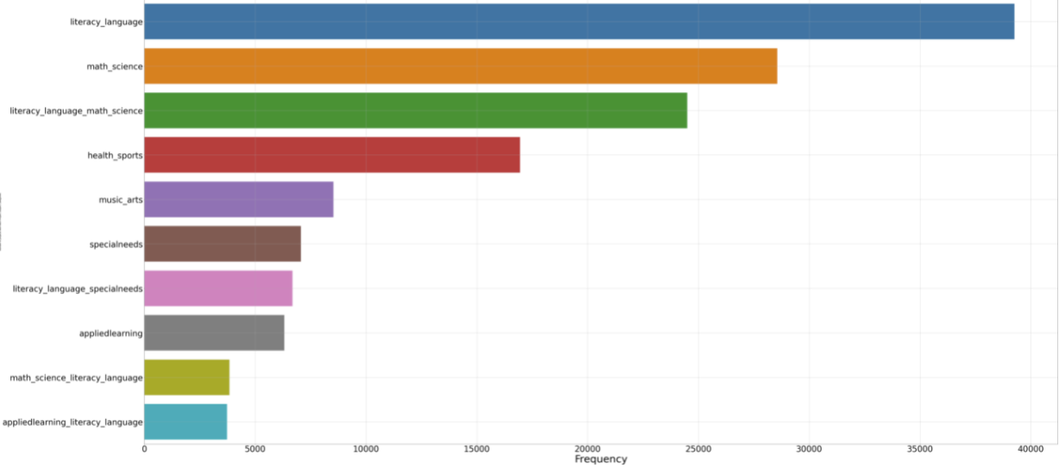


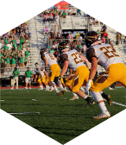
Subjects
Literacy and Language
Math and Science
Health and Sports
Show Code |

Slide 13

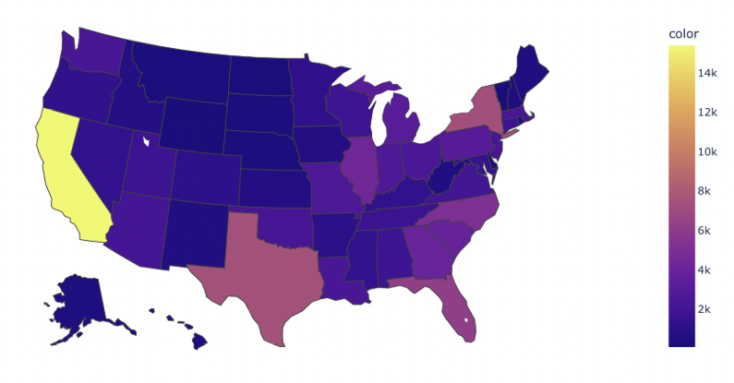



Applications from?
California(25.60k)
Texas(12.30k)
New York(12.15k)
Florida(10.35k)
Show Code |

Slide 14
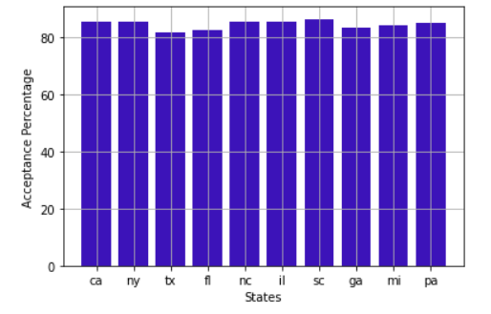

State-wise Acceptance Rate
While the maximum percentage of applications received are from CA, TX and NY, it's interesting to see all three of them as well as many other states have the same percentage of applications accepted.
Show Code |

Slide 15
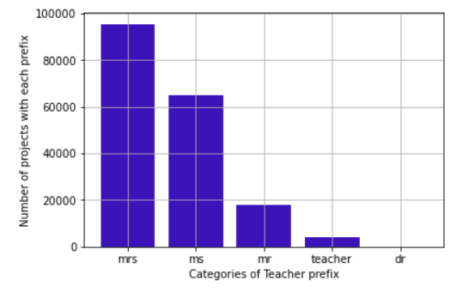
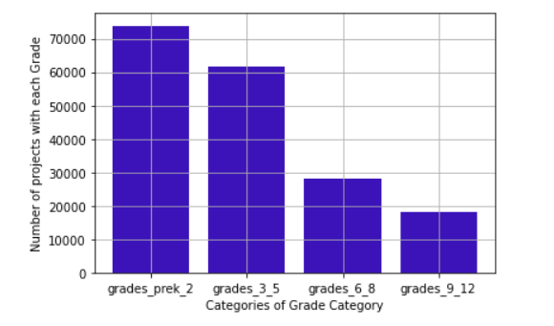
Understanding the Applicants
Teacher Categories
Grade Categories
Show Code |

Slide 16
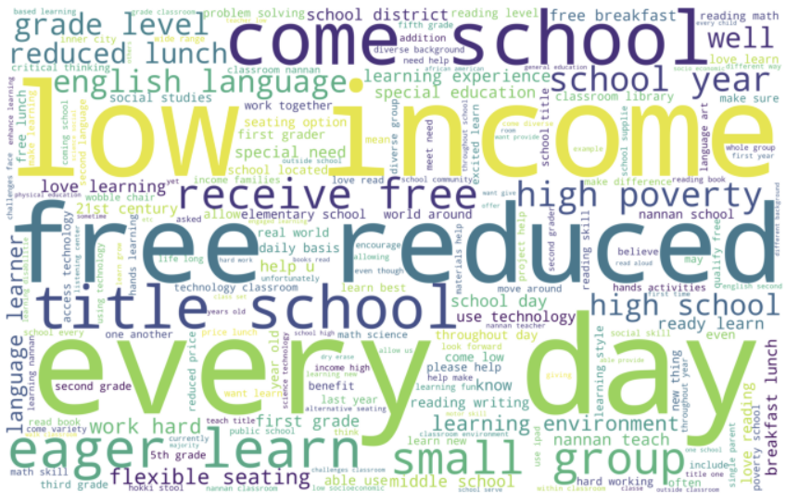
Top Words in Approved Projects
Show Code |

Slide 17

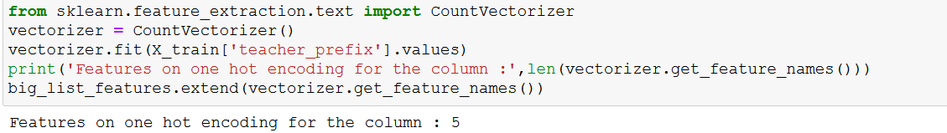
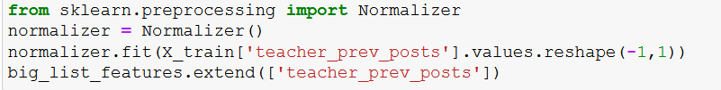
One-hot Encoding of data
One-hot Encoding
Importing count vectorizer below which helps in one-hot encoding of data
Normalizing the numeric data (non-textual) to use it in the model

Slide 18
Model Selection & Training
In the model, 80% data has been considered for Training the model and the remaining 20% for Testing.
The model is based on the Bernoulli Naive Bayes method, a supervised machine learning algorithm, which works on Bernoulli distribution and is used on discrete data.
It is useful when the dataset is large and category classification (prediction) is required.

Slide 19

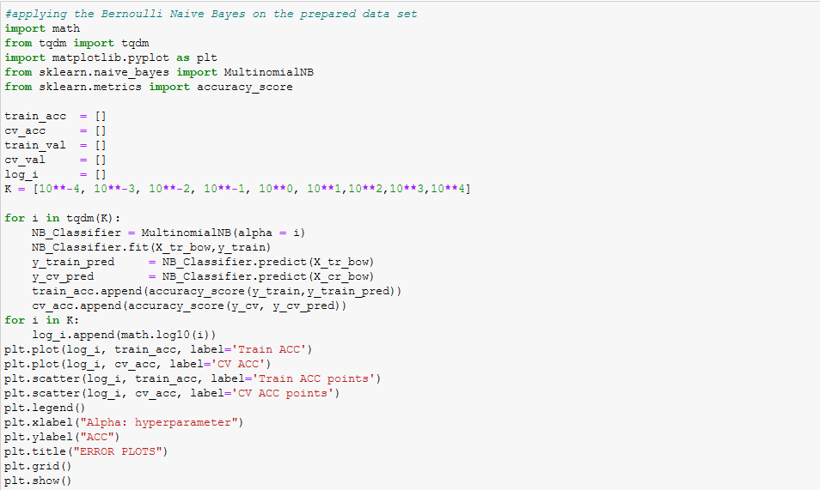
Importing Libraries
for Building
and Testing Model
Hyper Parameter Tuning

Slide 20

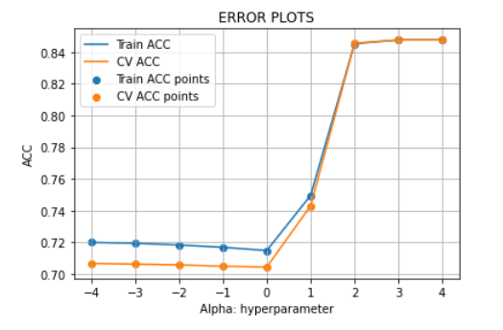
Model Accuracy
Highest Value of accuracy can be achieved at Alpha = 1000
Our model successfully classifies applications with an accuracy of 85%

Slide 21




Recommendations
For Applicants
Applications with quantified requirements have a greater chance of approval
Teachers who have previously received a project approval, have a greater chance of approval
Literature, Language, Math, Science and Sports have a greater chance of approval
For DonorsChoose/Volunteers
Use the model for initial screening of applications

Slide 22



Future Enhancements
For applicants
Better computational power and state of the art machine learning & deep learning algorithms can be implemented on the data to yield better accuracy.
With more data around number of students, our model can include more KPIs which can further enhance the donors-volunteer ecosystem.
For DonorsChoose/Volunteers
An automated screening mechanism can be built
Reject/Accept applications based on thresholds to save time

Slide 23
Thank You

Slide 24
Questions?
Modelling
Data
EDA
States
One hot encoding
Donors Choose
Grades
Model preparation
Data
Data-Cleaning
Project Summary
Accuracy
Extracting Stop words
Subjects
Recommendations
Word Cloud

